Slide 1
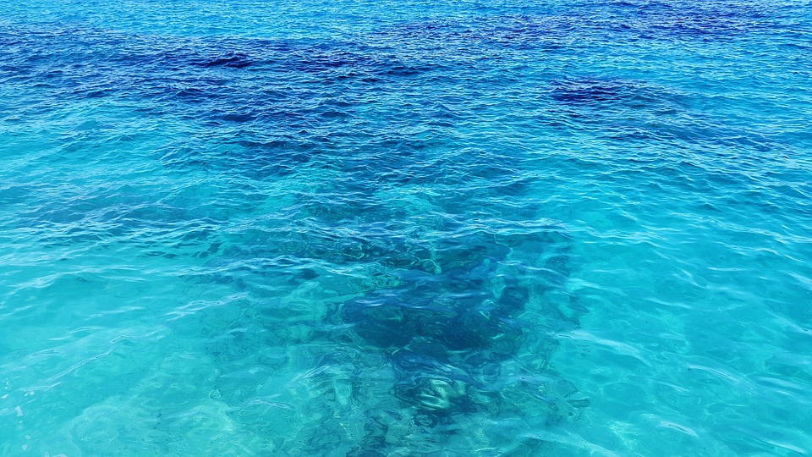
Squeezing water
Water is a made of particles.
1. How close together are the particles in liquid water?
A
They are touching each other.
B
There are small gaps between them.
C
There are big gaps between them,
but smaller gaps than between gas particles.

Slide 2
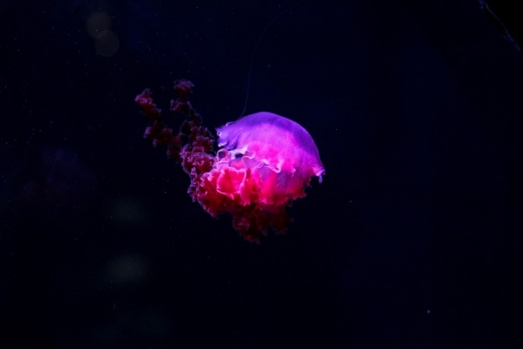
Squeezing water
Water at the bottom of the ocean is under a huge pressure.
2. Is this pressure large enough to squash water?
A
Water cannot be squashed.
B
Water is squashed a tiny bit.
C
Water is squashed more than a tiny bit.

